Slide 1
Predict the Probability of Purchasing
2011120355 윤희경
2011120290 심재민

Slide 2
Table of Contents
Data
Task
Progress
Plan

Slide 3
1 Data

Slide 4

1. Data
2) Datasize
54 attribute
9,917,530 records
Data includes (1) shopping and purchase data (2) Hotel characteristics (3) Location attractiveness of hotels (4) User’s aggregate purchase history (5) Competitive OTA information
1) Objective
Expedia is the world’s largest online travel agency and powers search results for millions of travel shoppers every day
having the best ranking of hotels (“sort”) for specific users with the best integration of price competitiveness gives an Expedia the best chance of winning the sale

Slide 5
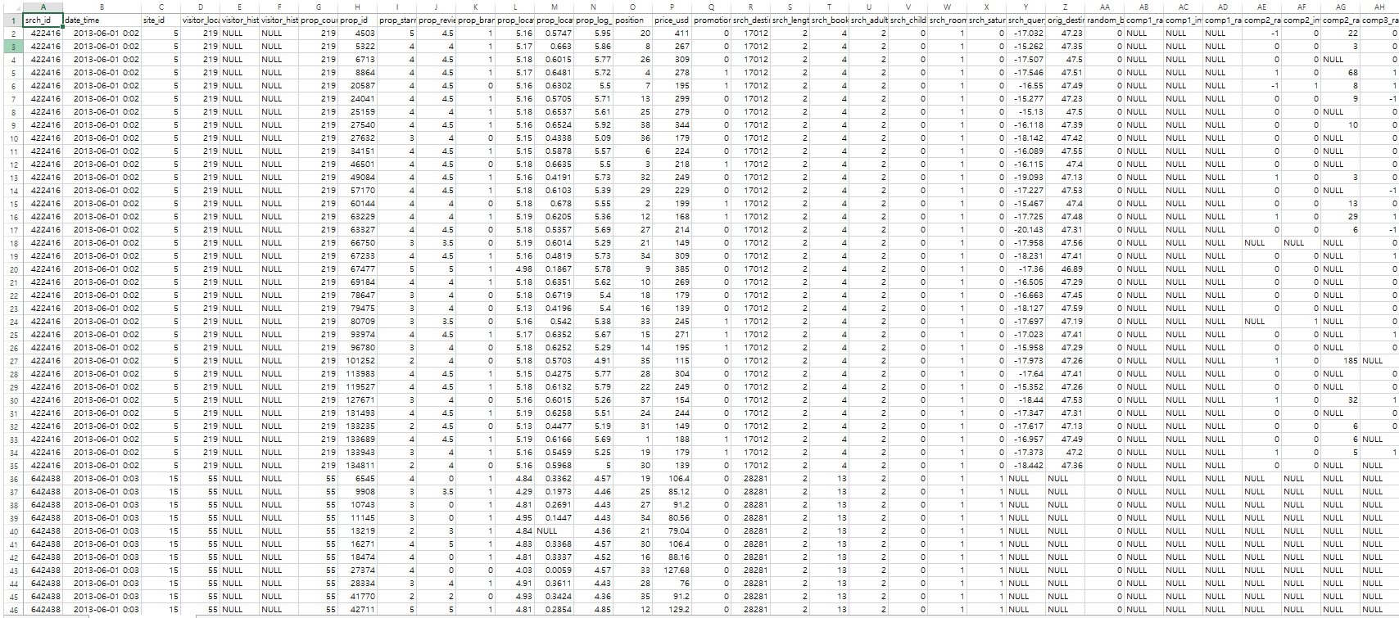

Slide 6
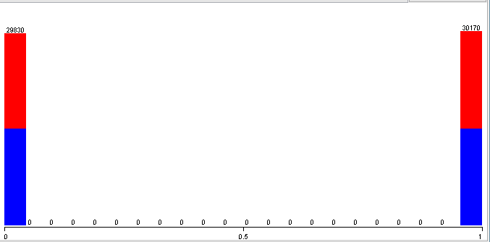
예약한 날짜중에 토요일 저녁이 포함되는 경우가 50%정도 된다.

Slide 7
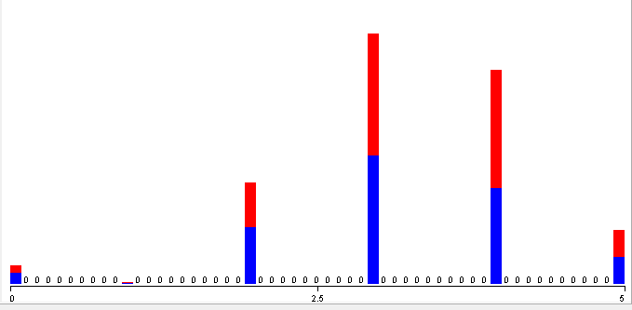
별 점 중에 3점에서 4.5점 사이가 많이 있었다.

Slide 8
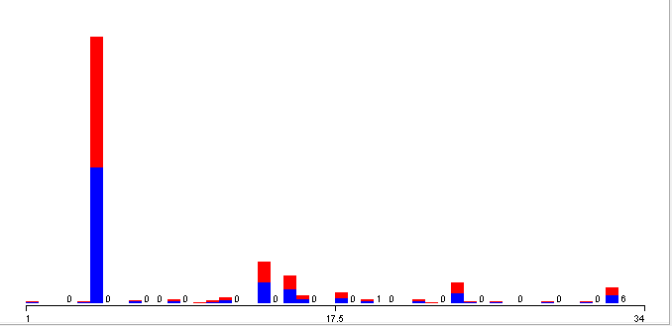
특정 국가 site domain(미국으로 예상)에 접속한 경우가 많음

Slide 9
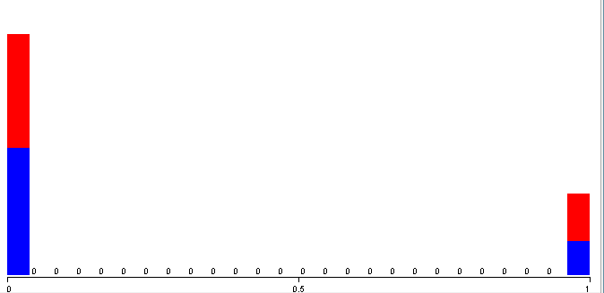
호텔의 21%정도가 할인행사를 진행한다.

Slide 10
2 Task

Slide 11
2 Task
개인별로 구매확률이 가장 높은 순서로 호텔 상품을 배열하여 구매율을 향상시킨다.
배열 기준: 구매확률
구매확률 예측 방법: 방문자 정보, 쿼리 정보, 호텔 상품 정보를 바탕으로 구매확률을 예측 (Logistic Regression 이용)

Slide 12
3 Progress

Slide 13
3 Progress
Data Processing
Data Mining
Predict
Delete unnecessary attributes Sampling 1 from each srch_id Convert non-numeric data into numeric data Convert numeric target value into non-numeric data type (to run logistic regression) | Clustering into 3 clusters Find optimum set of attributes (Classify: logistic regression) | Process test data Cluster the data Classify the data Rank the result

Slide 14
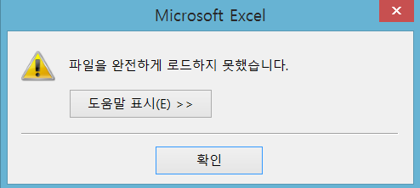
Data Processing
Excel로 파일을 열 수 없어서 R로 작업
1. Delete unnecessary attributes -R
2. Sampling 1 from each srch_id -R
3. Convert non-numeric data into numeric data -R
4. Convert numeric target value into non-numeric data type (to run logistic regression) -R

Slide 15
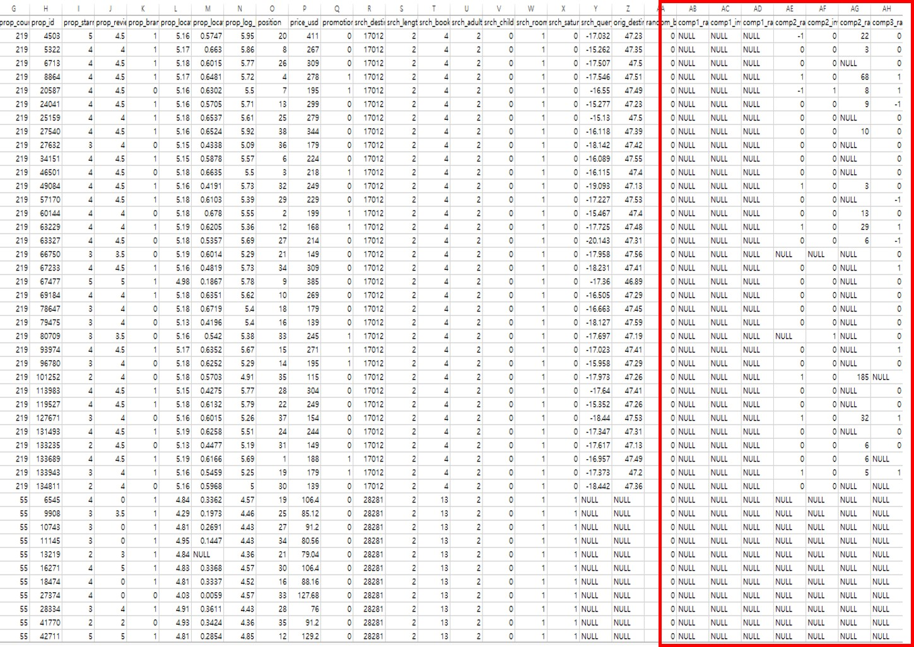
Data Processing : Delete unnecessary attributes

Slide 16
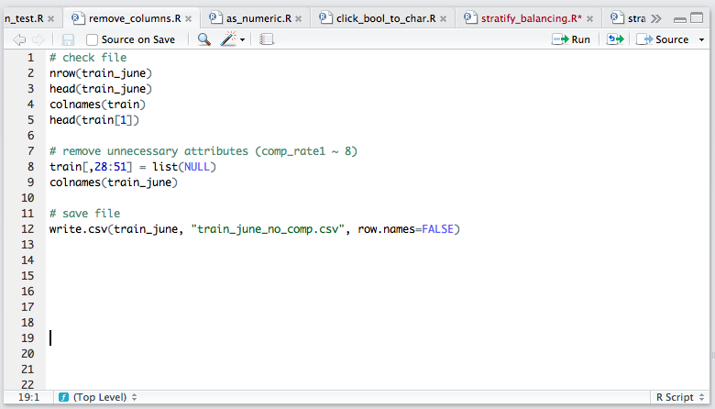
Data Processing : Delete unnecessary attributes

Slide 17
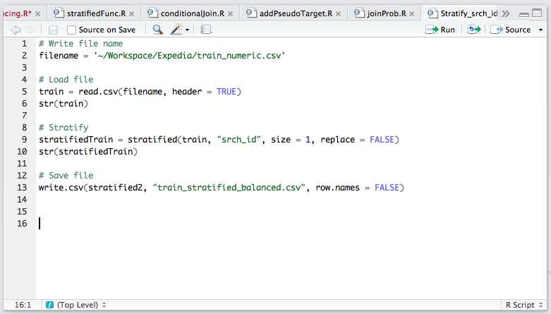
Data Processing : Sampling 1 from each srch_id

Slide 18
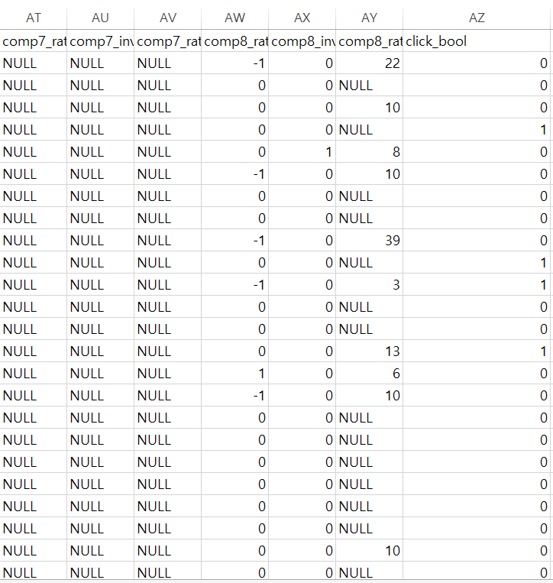
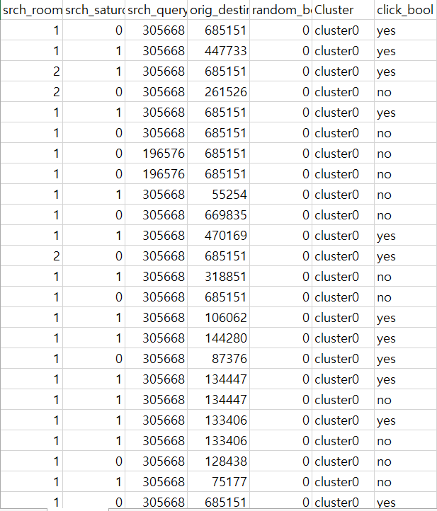
Data Processing : Convert non-numeric data into numeric data
Convert numeric target value into non-numeric data type (to run logistic regression)

Slide 19
3 Progress
Data Processing
Data Mining
Predict
Delete unnecessary attributes Sampling 1 from each srch_id Convert non-numeric data into numeric data Convert numeric target value into non-numeric data type (to run logistic regression) | Clustering into 3 clusters Find optimum set of attributes (Classify: logistic regression) | Process test data Cluster the data Classify the data Rank the result

Slide 20
Data Mining
1. Clustering into 3 clusters
2. Find optimum set of attributes

Slide 21
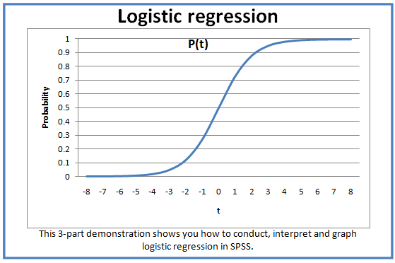
Logistic regression model

Slide 22
Data Mining : Find optimum set of attributes
=== Classifier model (full training set) ===
Logistic Regression with ridge parameter of 1.0E-8
Coefficients…
Class
Variable no
===============================
date_time 0
site_id -0.001
visitor_location_country_id 0.0005
visitor_hist_starrating -0.0002
visitor_hist_adr_usd 0
prop_country_id -0.0003
prop_starrating -0.0849
prop_review_score -0.014
prop_brand_bool -0.0143
prop_location_score1 0.0026
prop_location_score2 0
prop_log_historical_price -0.0316
position 0.05
price_usd 0
promotion_flag -0.2261
srch_destination_id 0
srch_length_of_stay 0.0064
srch_booking_window 0.0006
srch_adults_count -0.033
srch_children_count 0.0057
srch_room_count 0.0219
srch_saturday_night_bool -0.0429
srch_query_affinity_score 0
orig_destination_distance 0
Intercept -0.0082

Slide 23
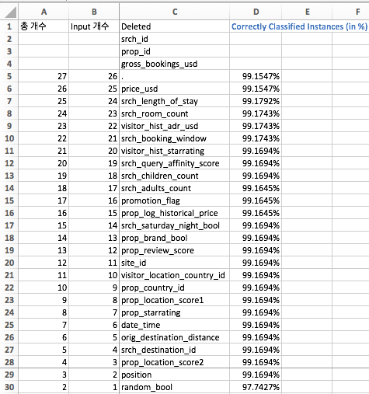
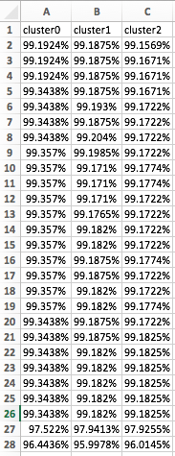
Data Mining: find optimum set of attributes
Entire data set
Cluster0 /Clsuter1/ Cluster2

Slide 24
Trouble Shooting
Problem
Solution
1. Two Target Values
One Target Value
2. Unbalanced Data
Balancing data

Slide 25
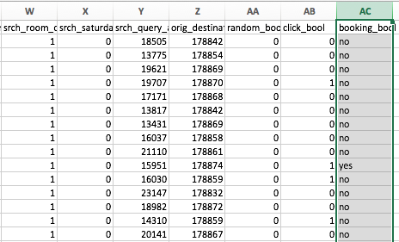
Problem 1. Two Target Values
New Data for Prediction

Slide 26
Solution 1. Target click_bool

Slide 27
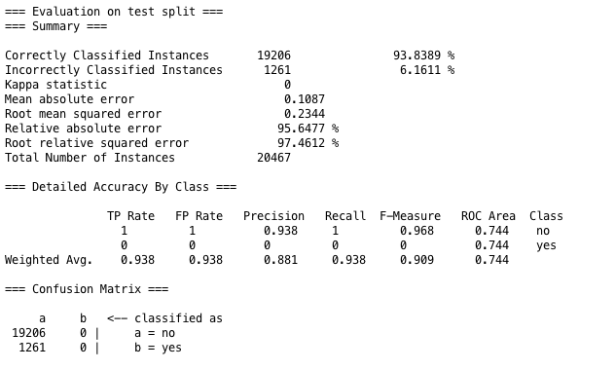
Problem 2. Unbalanced Data
How well other attributes predict click_bool? -> Not at all.

Slide 28
Solution 2. Balancing Data
9,917,530 records
887,344 records
60,000 records
NO 9,473,858
YES 443,672
Balancing
Stratified
Sampling
NO 443,672
YES 443,672
NO 30,000
YES 30,000

Slide 29
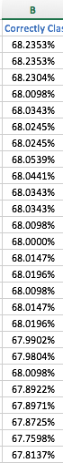
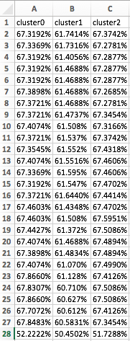
Target booking_bool
With click_bool
Target click_bool
Without click_bool + Balanced Data

Slide 30
Coefficients
Positively Correlated
Negatively Correlated
Srch_length_of_stay
Srch_booking_window
Srch_room_count
Prop_starrating
Prop_review_score
Prop_brand_bool
srch_Saturday_night_bool

Slide 31
Coefficients
Positively Correlated
Negatively Correlated
숙박 기간이 길수록
여행 전에 미리 알아볼수록
예약 방 갯수가 많을 수록
별점이 낮을수록
평점이 낮을수록
브랜드 호텔이 아닐수록
숙박기간 중에 토요일이 포함되지 않을수록

Slide 32
4 Predict

Slide 33
4 Predict
Data Processing
Data Mining
Predict
Sampling 1 from each srch_id Convert non-numeric data into numeric data Delete unnecessary attributes Convert numeric target value into non-numeric data type (to run logistic regression) | Clustering into 3 clusters Find optimum set of attributes (Classify: logistic regression) | Process test data Cluster the data Classify the data Rank the result

Slide 34
Predict
1 Process
Test Data
Remove unnecessary attributes (R)
Into numeric values (R)
2 Cluster
Test Data
Cluster as supplied test set (weka)
Join (R)
3 Classify
Test Data
Add pseudo target (R)
Temporarily remove srch_id, prop_id columns (R)
Predict as supplied test set (weka)
4 Rank
the Result
Text into csv (python)
Join probability with data (R)
Sort by srch_id, probability (excel)

Slide 35
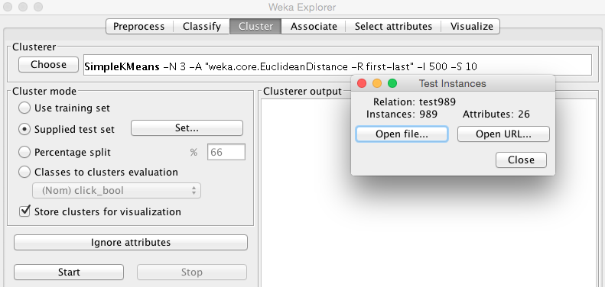
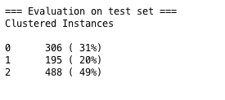
2 Cluster Test Data: cluster with supplied test set

Slide 36
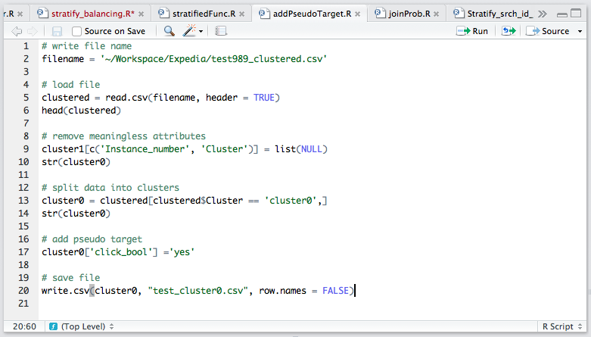
3 Classify Test Data: split into clusters & add pseudo targets

Slide 37
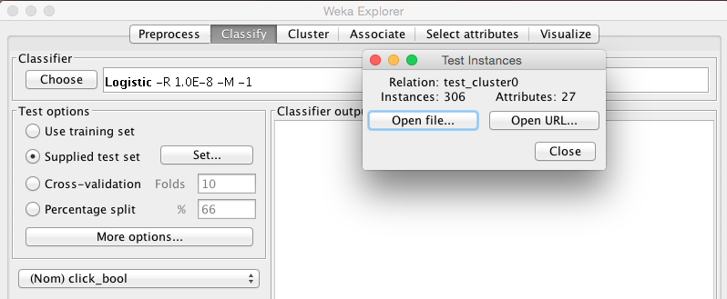
3 Classify Test Data: classify with supplied test set

Slide 38
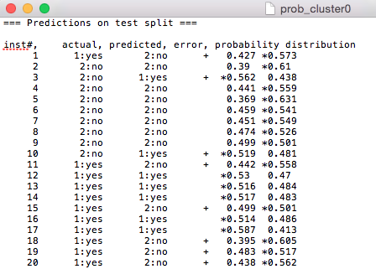

4 Rank the Result: Probability text into csv file
.txt
.csv

Slide 39
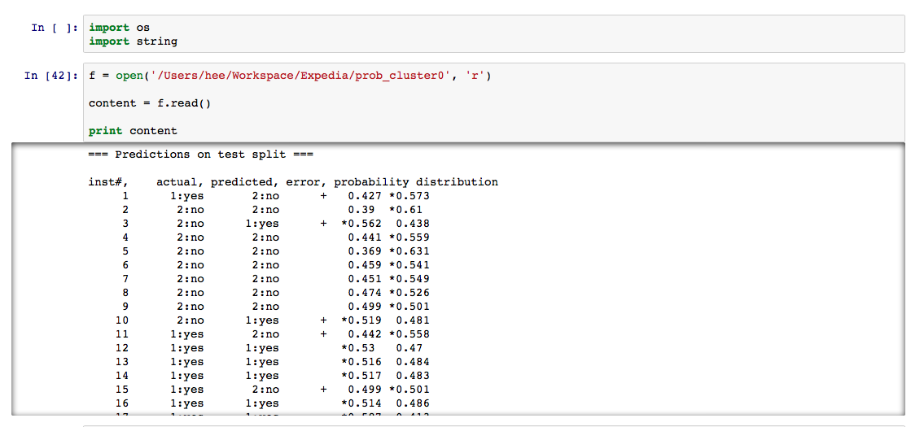
4 Rank the Result: Probability text into csv file

Slide 40
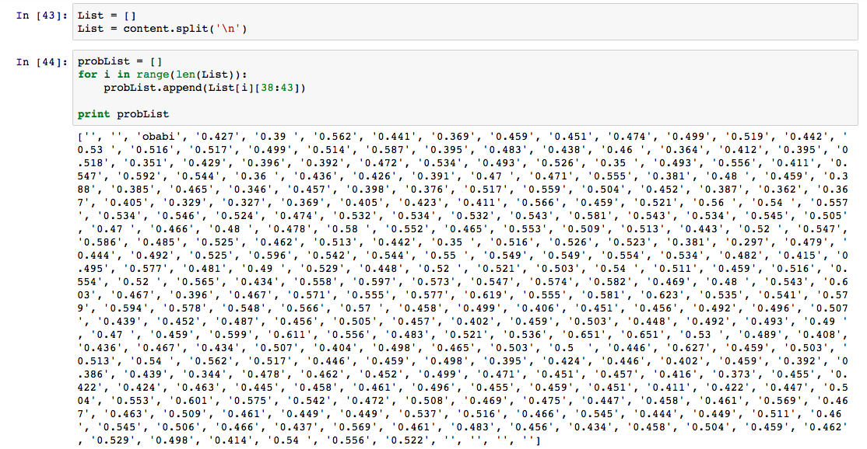
4 Rank the Result: Probability text into csv file

Slide 41
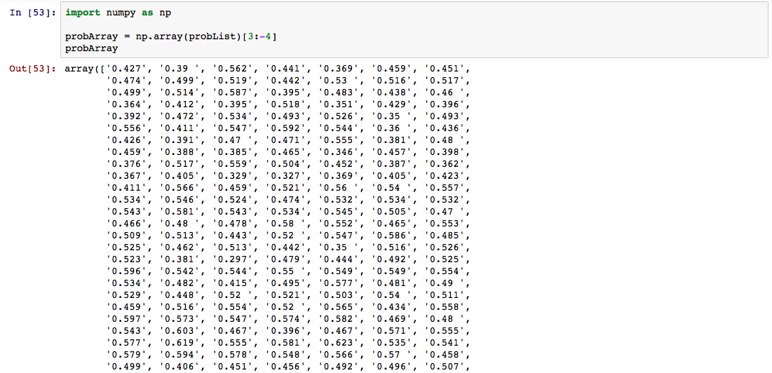
4 Rank the Result: Probability text into csv file

Slide 42
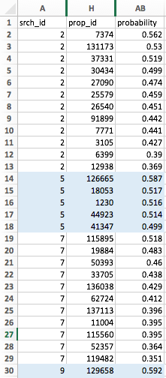
4 Rank the Result: sort by srch_id & probability

Slide 43
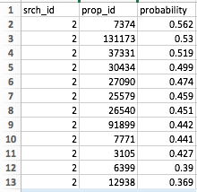
4 Rank the Result: sort by srch_id & probability
Highest Probability of clicking
Lowest Probability of clicking
Task Complete:
개인별로 구매확률이 가장 높은 순서로 호텔 상품을 배열하여 구매율을 향상시킨다.

Slide 44
검색 결과 예시
## Hostel
Prop_id 7374
$$ Hotel
Prop_id 131173
^^ Guest House
Prop_id 37331

